Slide 1
CHAPTER 1: Distributed System Models and Enabling Technologies
System Models for Distributed and Cloud Computing
1.3.1 Clusters of Cooperative Computers
1.3.2 Grid Computing Infrastructures
1.3.3 Peer-to-Peer Network Families
1.3.4 Cloud Computing over the Internet

Slide 2
SYSTEM MODELS FOR DISTRIBUTED AND CLOUD COMPUTING
Distributed & cloud computing systems - built over a large no. of autonomous computer nodes.
Node machines - interconnected by SANs, LANs, or WANs in a hierarchical manner.
Thus, we can build a massive system - with millions of computers connected networks.
Massive systems - highly scalable, reach web-scale connectivity, either physically or logically.
In Table 1.2, massive systems are classified into four groups: clusters, P2P networks, computing grids, and Internet clouds over huge data centers.
Table – characterize four system classes (technical & application aspects).

Slide 3
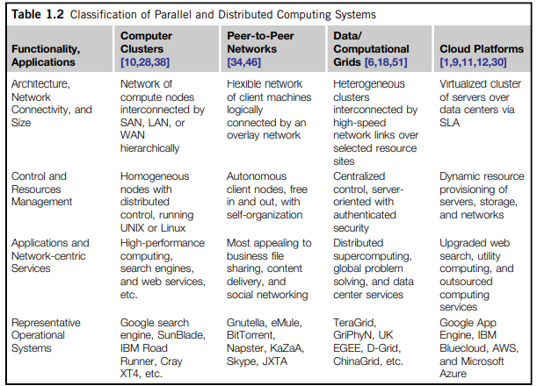

Slide 4
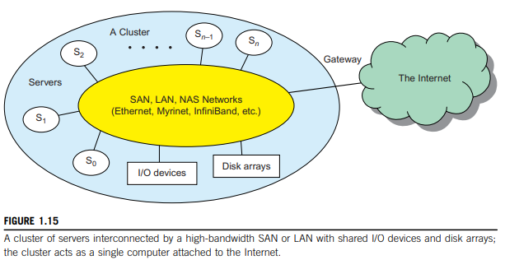
Clusters of Cooperative Computers
Computing cluster - consists of interconnected computers
- which work cooperatively
- as single integrated computing resource.
Through hierarchical construction - using a SAN, LAN, or WAN, - we can build scalable clusters with an increasing number of nodes.
cluster is connected to Internet - a virtual private network (VPN) gateway. gateway IP address locates the cluster.

Slide 5
Single-System Image
An ideal cluster - merge multiple system images into a single-system image (SSI).
An SSI is an illusion - created by software or hardware that presents a collection of resources as one integrated, powerful resource.
SSI makes the cluster - appear like a single machine to the user.

Slide 6
Hardware, Software, and Middleware Support
Computer nodes - interconnected by a high-bandwidth network (such as Gigabit Ethernet, Myrinet, InfiniBand, etc.).
Special cluster middleware supports - needed to create SSI or high availability (HA).
Both sequential & parallel applications - can run on the cluster
Special parallel environments - needed to facilitate use of the cluster resources.
For ex: distributed memory has multiple images.
Users may want all distributed memory to be shared by all servers - distributed shared memory (DSM).
DSM-Virtualization(on demand) - Using virtualization, we can build many virtual clusters dynamically.

Slide 7
Major Cluster Design Issues
Without middleware - cluster nodes cannot work together effectively (to achieve cooperative computing).
Software environments & applications - must rely on middleware (to achieve high performance).
The cluster benefits come from:
scalable performance,
efficient message passing,
high system availability,
seamless fault tolerance.

Slide 8
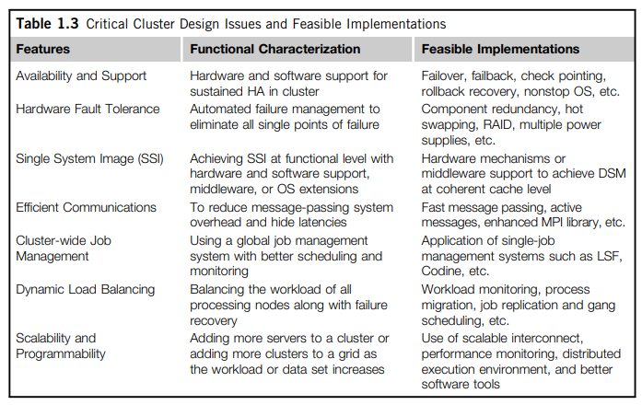

Slide 9
Grid Computing Infrastructures
Past 30 years - a natural growth path from Internet to web and grid computing services.
Internet services such as - Telnet command enables a local computer to connect to a remote computer.
Web service such as - HTTP enables remote access of remote web pages.
Grid computing - envisioned to allow close interaction among applications, running on distant computers simultaneously.

Slide 10
Computational Grids
Like an electric utility power grid - a computing grid offers an infrastructure (couples computers, software/middleware, special instruments, and people and sensors together).
Grid is often constructed across LAN, WAN, or Internet backbone networks (at regional, national, or global scale).
Computers used in a grid are primarily workstations, servers, clusters, and supercomputers.
Figure 1.16 shows an example computational grid built over multiple resource sites owned by different organizations.
Grid is presented to users as an integrated resource pool as shown in the upper half of the figure.

Slide 11
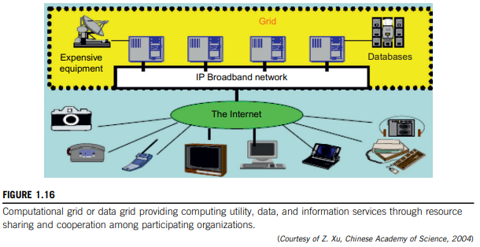

Slide 12
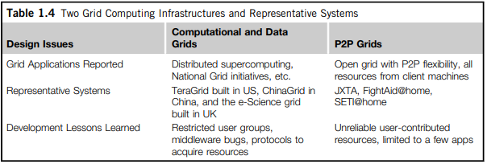
Grid Families
Grid technology demands:
new distributed computing models, software/middleware support, network protocols, and hardware infrastructures.
In Table 1.4, grid systems are classified in two categories: computational or data grids and P2P grids. Computing or data grids are built primarily at the national level.

Slide 13
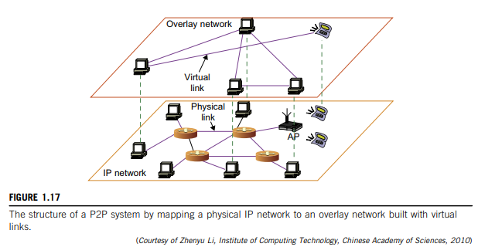
Peer-to-Peer Network Families
A P2P network is client-oriented instead of server-oriented.
No central coordination or central database is needed.
Hence, no peer machine has global view of the entire P2P system.
Figure 1.17 shows the architecture of a P2P network at two abstraction levels.
Initially, the peers are totally unrelated.
Each peer machine joins or leaves the P2P network voluntarily.
Only the participating peers form the physical network at any time.
Unlike cluster or grid, P2P network does not use a dedicated interconnection network.

Slide 14
Overlay Networks
Data items or files are distributed in the participating peers.
Based on communication or file-sharing needs, peer IDs - form an overlay network at the logical level.
This overlay is a virtual network formed by mapping each physical machine with its ID, logically, through a virtual mapping as shown in Figure 1.17.
When a new peer joins the system, its peer ID is added as a node in the overlay network.
When an existing peer leaves the system, its peer ID is removed from the overlay network automatically.
Therefore, it is the P2P overlay network that characterizes the logical connectivity among the peers.

Slide 15
There are two types of overlay networks: unstructured and structured.
An unstructured overlay network is characterized by a random graph.
    There is no fixed route to send messages or files among the nodes.
    Flooding is applied to send a query to all nodes in an unstructured overlay,
    thus resulting in heavy network traffic and nondeterministic search results.
  Structured overlay networks follow certain connectivity topology and rules for inserting and removing nodes (peer IDs) from the overlay graph.
Routing mechanisms are developed to take advantage of the structured overlays.

Slide 16
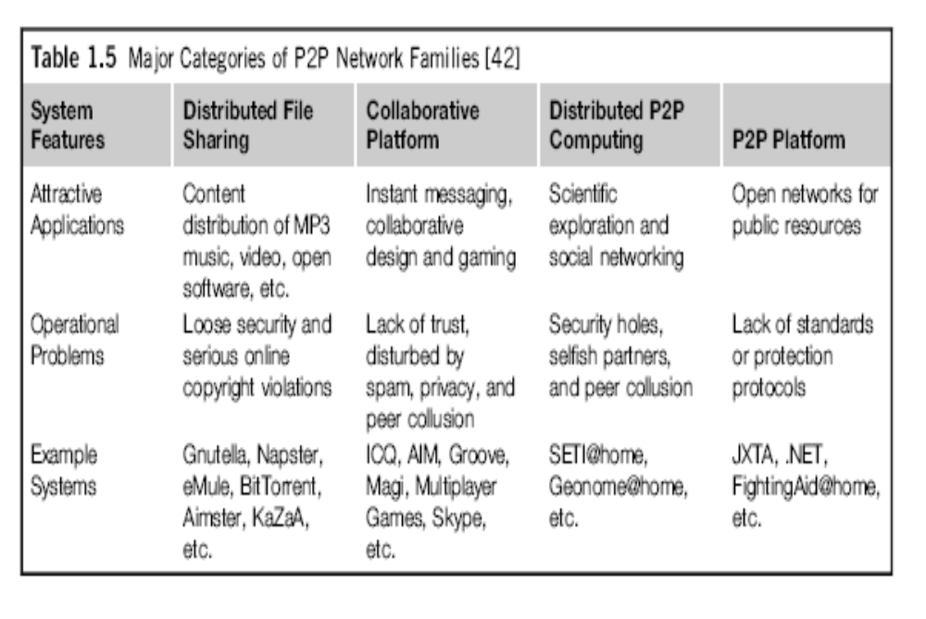

Slide 17
Challenges – P2P
P2P computing faces three types of heterogeneity problems: hardware, software, and network requirements.
too many hardware models and architectures to select from;
incompatibility exists between software and the OS; and
different network connections and protocols make it too complex to apply in real applications
Lack of trust among peers poses another problem; Peers are strangers to one another.
System is not centralized, so managing it is difficult.
System lacks security. Anyone can log on to the system and cause damage or abuse.
Further, all client computers connected to a P2P network cannot be considered reliable or virus-free.
In summary, P2P networks are reliable for a small number of peer nodes.

Slide 18
Cloud Computing over the Internet
Trend in IT - moving computing and data from desktops to large data centers.
This data explosion - promoted the idea of cloud computing.
Cloud computing - defined differently by many users and designers.
For ex, IBM, has defined it as follows: “A cloud is a pool of virtualized computer resources. A cloud can host a variety of different workloads, including batch-style backend jobs and interactive and user-facing applications.”
A cloud infrastructure provides a framework to manage scalable, reliable, on-demand access to applications.
A model of computation and data storage based on “pay as you go” access to “unlimited” remote data center capabilities.

Slide 19
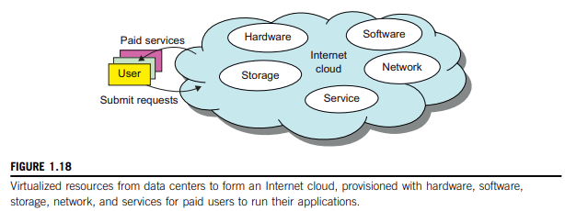
Internet Clouds
Cloud computing - virtualized platform with elastic resources on demand by provisioning hardware, software, and data sets dynamically (see Figure 1.18).
Idea is to move desktop computing to a service-oriented platform (using server clusters & huge databases at data centers).
Cloud computing leverages its low cost and simplicity - benefits both users and providers.
Cloud computing - satisfy many user applications simultaneously.
Cloud ecosystem – must be designed to be secure, trustworthy, and dependable.

Slide 20
The Cloud Landscape
Traditionally, a distributed computing system:
- owned and operated by an autonomous administrative domain (a research laboratory or company)
- for on-premises computing needs.
Traditional systems - several performance bottlenecks:
- constant system maintenance, poor utilization,
- increasing costs associated with hardware/software upgrades.
Cloud computing - as an on-demand computing paradigm resolves or relieves us from these problems.
Figure 1.19 depicts the cloud landscape and major cloud players, based on three cloud service models.

Slide 21
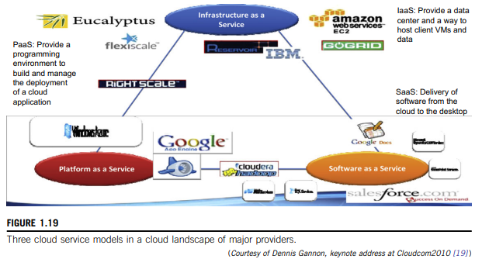

Slide 22
Infrastructure as a Service (IaaS):
- puts together infrastructures demanded by users
- servers, storage, networks, and the data center fabric
- user can deploy and run on multiple VMs running guest OSes
- user does not manage or control the underlying cloud infrastructure,
- but can specify when to request and release the needed resources.
Platform as a Service (PaaS):
- enables the user to deploy user-built applications onto a virtualized cloud platform.
- includes middleware, databases, development tools,
- both hardware & software are integrated with specific programming interfaces
- user is freed from managing the cloud infrastructure.
Software as a Service (SaaS):
- browser-initiated application software over thousands of paid cloud customers.
- customer side - no upfront investment in servers or software licensing.
- provider side - costs are rather low, compared with conventional hosting of user applications.

Slide 23
Internet clouds offer four deployment modes: private, public, managed, and hybrid [11].
These modes demand different levels of security implications.
Different SLAs imply that the security responsibility is shared among all the cloud providers, the cloud resource consumers, and the third party cloud-enabled software providers.
Eight reasons to adapt the cloud for upgraded Internet applications and web services:
  1. Desired location in areas with protected space & higher energy efficiency
  2. Sharing of peak-load capacity among a large pool of users, improving overall utilization
  3. Separation of infrastructure maintenance duties from domain-specific application development
  4. Significant reduction in cloud computing cost, compared with traditional computing paradigms
  5. Cloud computing programming and application development
  6. Service and data discovery and content/service distribution
  7. Privacy, security, copyright, and reliability issues
  8. Service agreements, business models, and pricing policies

